Slide 1
Twininet SDN
Social Media Powered Software Defined Networking

Slide 2
Modeling Networks
#CLUS is Networking for Networkers
Twininet Models their interactions in an actual network
Twininet – The Internet of Tweets (IOT)

Slide 3
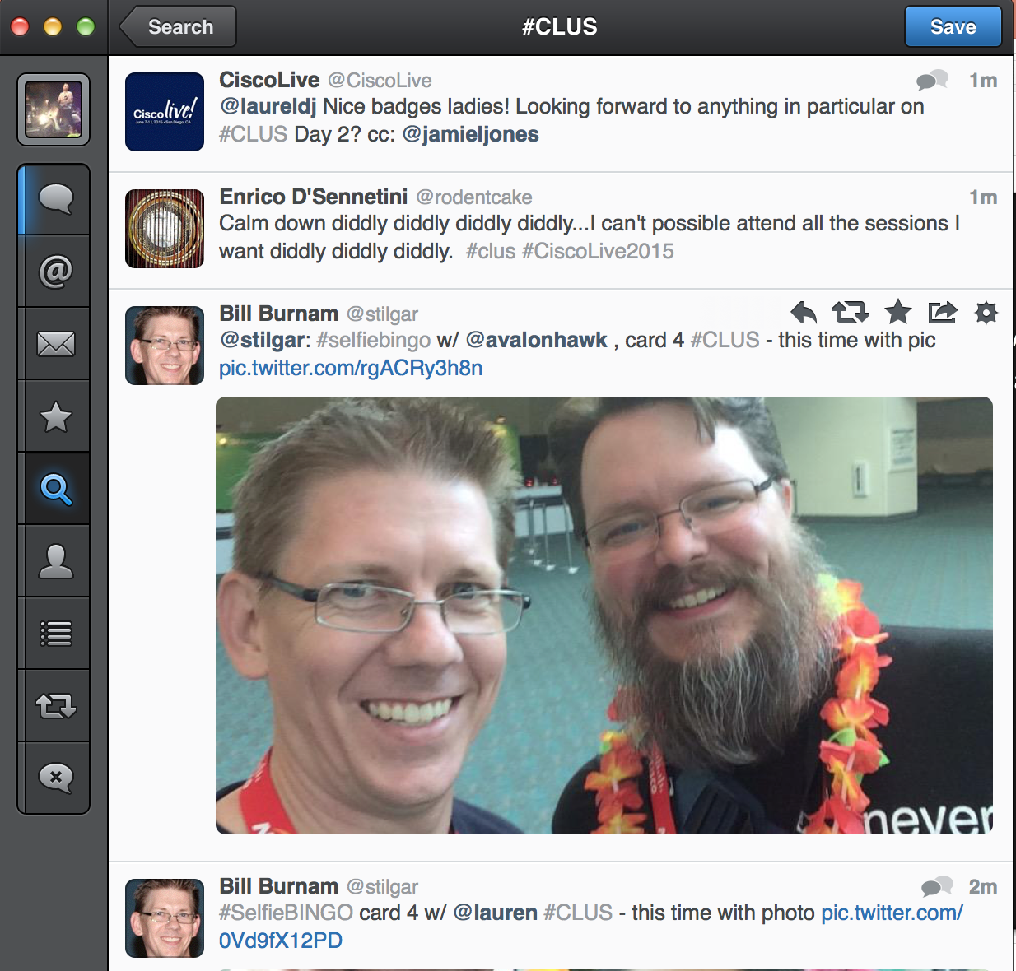
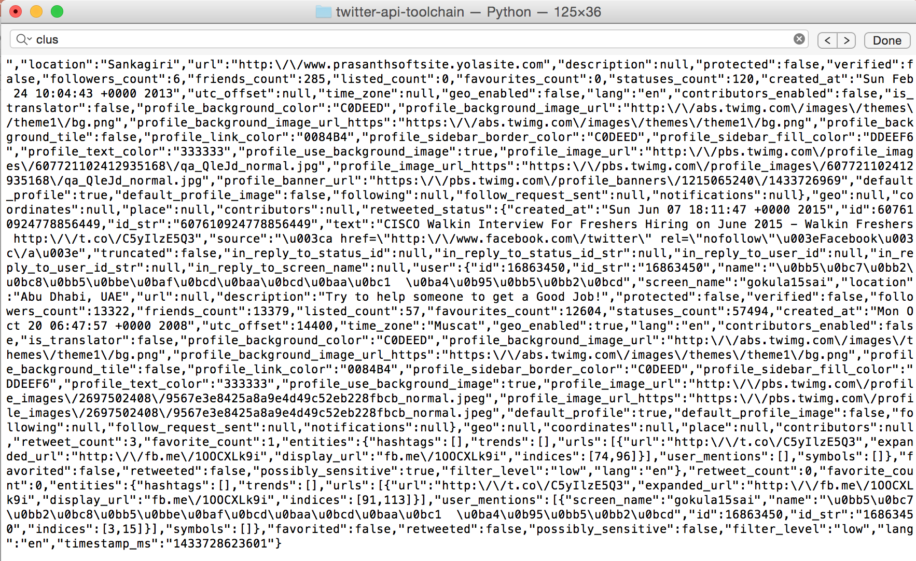
Are big conferences big data?
#CLUS pulled to create a data centric view of the conference

Slide 4

Components

Slide 5
Challenges

Slide 6
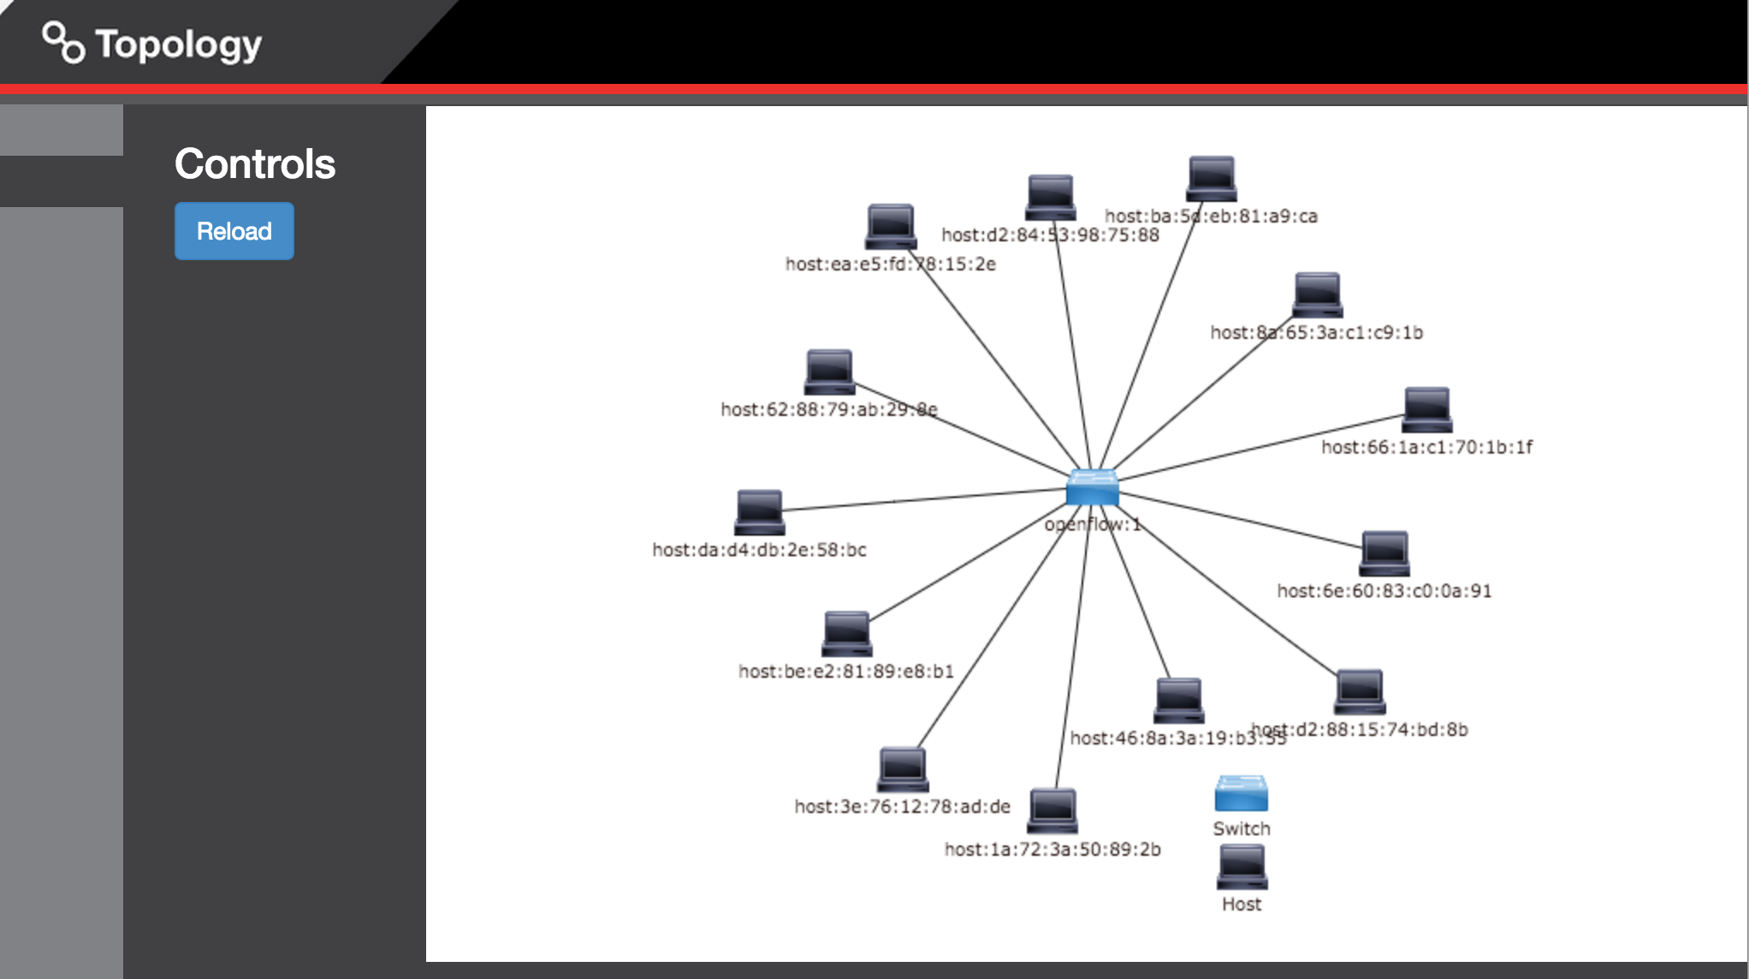
Results – IT WORKS!!!

Slide 7

Questions? More Information?
Aimon.Bustardo@nexusis.com
Lamberto.diwa@nexusis.com
Tmagil@sigmanet.com
Colin.McNamara@nexusis.com
Tubraiz.Mahmud@zaviya.net

